Slide 1

Exploring Dynamics and Trends in
Distance Education
Insights from Global Web Search Queries in the Post-Pandemic Era
8TH INTERNATIONAL CONFERENCE ON EDUCATION AND DISTANCE LEARNING
Priyanga Dilini Talagala
Senior Lecturer
Department of Computational Mathematics
University of Moratuwa, Sri Lanka
July 5, 2024

Slide 2



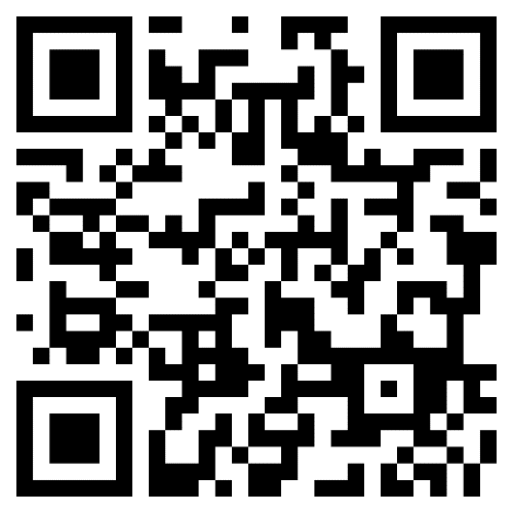





Data and codes available at: https://github.com/pridiltal/CARMA2024_Analysis
This work was supported in part by the RETINA research lab, funded by the OWSD, a program unit of the United Nations Educational, Scientific, and Cultural Organization (UNESCO).
Slides available at
Priyanga Dilini Talagala
PhD (Monash)
prital.netlify.app
pridiltal
Thiyanga S. Talagala
PhD (Monash)
thiyanga.netlify.app
thiyangt

Slide 3
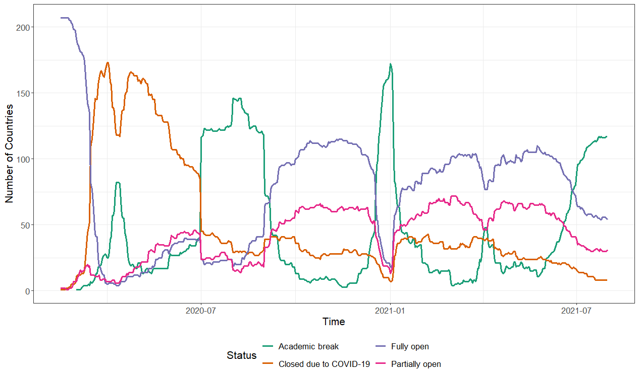
Global tracking of COVID-19 caused school closures and re-openings
Source: UNESCO (2020). COVID-19 educational disruption and response. [Online; accessed 13-May-2020]. https://en.unesco.org/covid19/educationresponse
Notes:
As we all know COVID 19 pandemic is one of the most impactful events of the 21 st centurary.
Among many sectors, education is one of the most affected sectors by the COVID 19 Pandemic
This figure shows the evolution of region wise school closures and reopenings due to the COVID 19 Pandemic
The Orange line here represents the school closures due to covid 19 pandemic.
We can see that, with the start of the Pandemic there is a near total closure of schools all around the world

Slide 4

From chalk-talk to virtual walk
The speed of these school closures demanded a rapid move from traditional classroom learning to online learning.

Slide 5
Distance education has a long history.
COVID-19 marked a new era of distance education.
Because during this pandemic, every single step, including, planning, developing new tools and techniques, conducting awareness programs about online learning and shifting towards online learning, happened online, due to the unexpected massive global shutdown.
This lack of experience, lack of awareness and lack of readiness caused millions of distance education related internet searches during the COVID-19 pandemic.

Slide 6
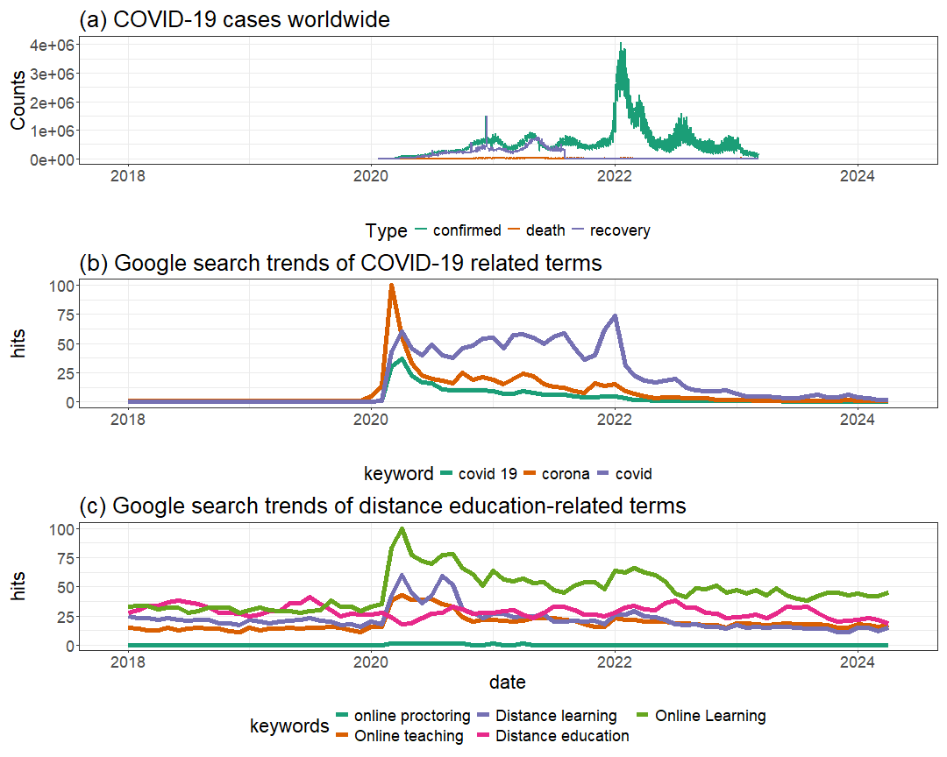

Slide 7
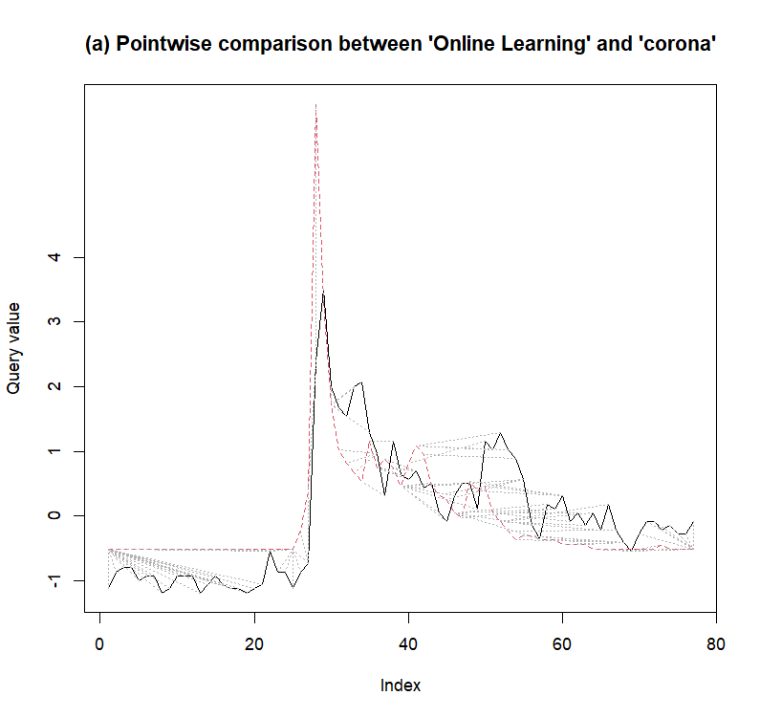
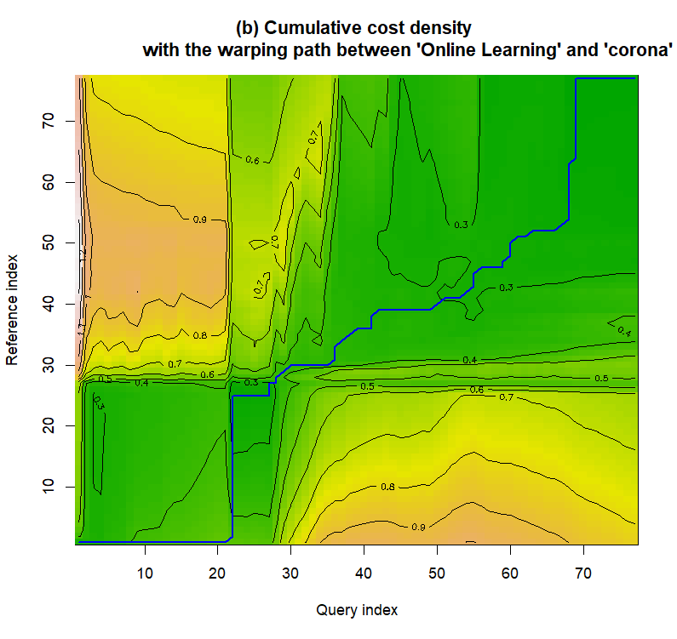
Corona
Online Learning
2018
2020
2022
2024
2018
2020
2022
2024

Slide 8
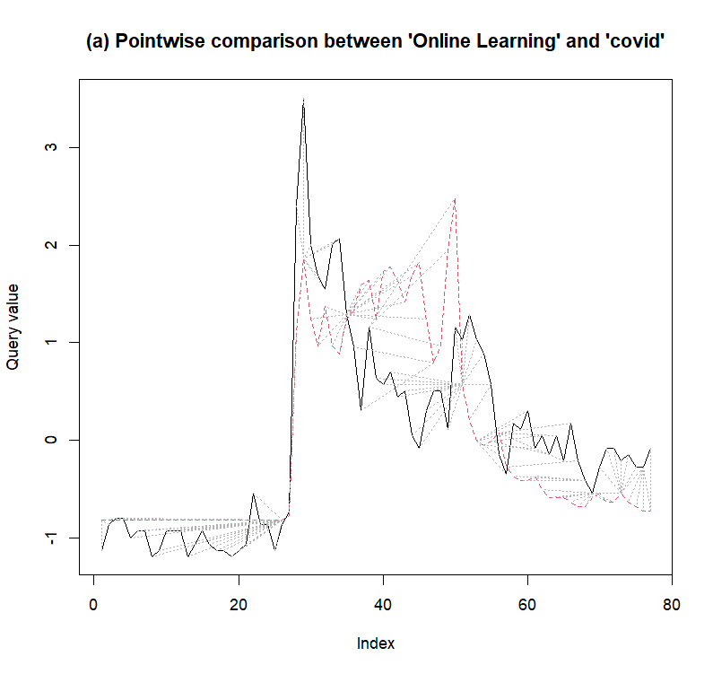
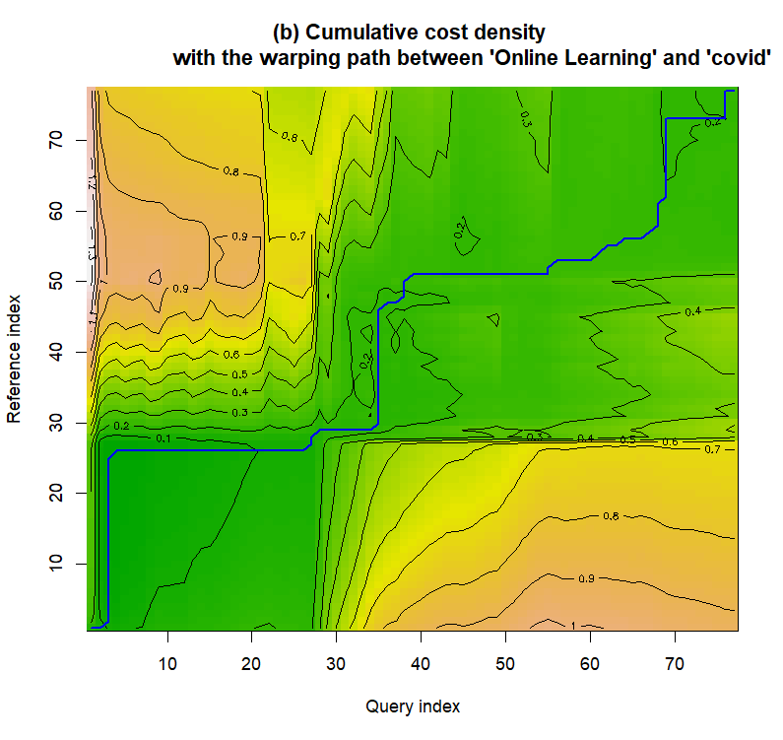
Online Learning
COVID
2018
2020
2022
2024
2018
2020
2022
2024

Slide 9
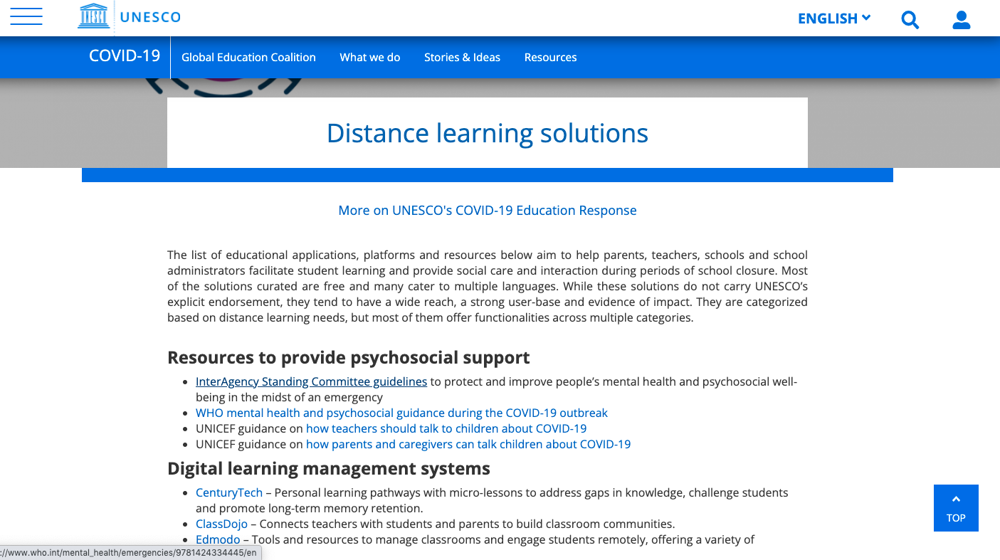
In response to this sudden massive transfer from traditional classroom learning to online learning, UNESCO took immediate action by publishing a list of existing tools to facilitate distance education during the period of school closure.
UNESCO (2020). Distance learning solutions. [Online; accessed 13-May-2020]. https://en.
unesco.org/covid19/educationresponse/solutions

Slide 10
Google Trends Analysis in Distance Education
Aim: To explore if Google Trends search queries can be used as a proxy to quantify the popularity and public interest in various distance education options during and after the COVID-19 pandemic.
Google Trends: An open-source web analytics tool offering insights into internet search behaviour.
Provides a relative search volume scaled from 0 to 100, indicating interest relative to the highest point in the series for the chosen region and time.
A value of 100 indicates the peak popularity of a term within the specified time frame.
Notes:
This was actually the main motivation behind our research.
We wanted to check whether google ….
You are already familiar with Google trends. We had several sessions on this.
Google trend….

Slide 11
Google Trends Analysis in Distance Education
Timeframe: December 2019 to April 2024
Key Questions:
What solutions have emerged to meet the demands of distance education during and post COVID-19? (Emergent Solutions)
Which distance learning solutions have garnered widespread attention and public interest? (Public Interest)
Selected search terms based on UNESCO's list of distance learning solutions (UNESCO, 2020).
Concentrated on the education category to improve data relevance and accuracy (Vaughan & Romero‐Frías, 2014).
Avoided acronyms to prevent confusion, focusing on specific tools and techniques in the market (Vaughan & Romero-Frias, 2014).

Slide 12
Segmentation of Analysis
Digital learning management systems
Systems designed for basic mobile phone usage
Systems with strong offline functionalities
Massive Open Online Course (MOOC) platforms
Self-directed learning resources
Mobile reading apps
Collaboration platforms facilitating live-video communication
Tools for educators to create digital learning content
External repositories of distance learning solutions
Tools for Online proctoring
Psychosocial support
Notes:
Deciding on the appropriate search term in Google Trends is crucial, as each term carries
different search volumes . Our analysis encompassed 11 distinct sub-categorie
. In our study, we considered the list of distance
learning solutions published by UNESCO when choosing our search term (UNESCO, 2020a).
Although these solutions are not explicitly endorsed by UNESCO, they typically possess
extensive reach, a sizable user base, and evidence of effectiveness (UNESCO, 2020a).
This
segmentation was primarily guided by UNESCO's compilation of distance learning solutions
issued in response to the COVID-19 pandemic

Slide 13
Handling Google Trends Query Limitations
In Google trends, it is possible to search for only up to five queries at a time.
Under each segmentation, we entered up to five distance learning tools at a time and recorded their relative ranking scores.
An iterative pairwise comparison was used to identify tool with the highest relative ranking score during the study period.
Used this highest-ranked tool as a reference point for obtaining the relative ranking scores of other tools.

Slide 14

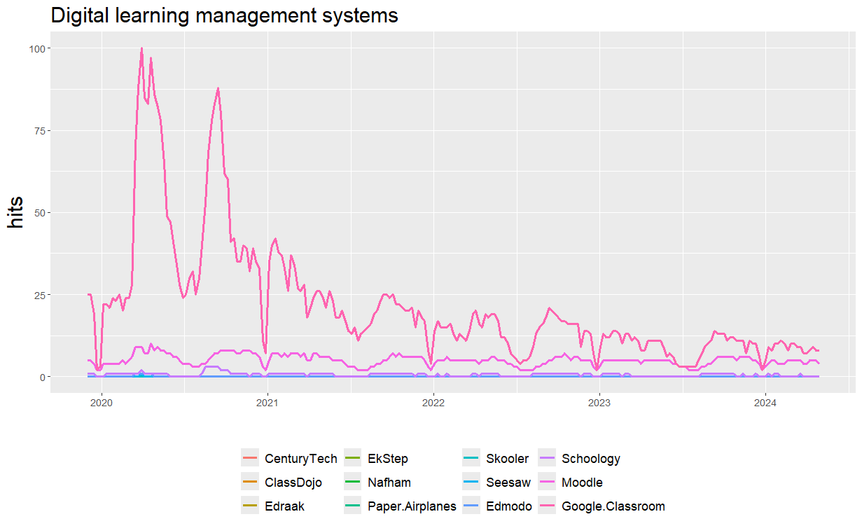
Image Source: https://www.didasko-online.com/wp-content/uploads/2022/09/LMS-and-learning-icons-with-man-using-computer-as-background.jpg
Notes:
A Digital Learning Management System (LMS) is a software application or web-based technology used to plan, implement, and assess a specific learning process. It provides educators with tools to create and deliver content, monitor student participation, and assess performance. Features often include:

Slide 15

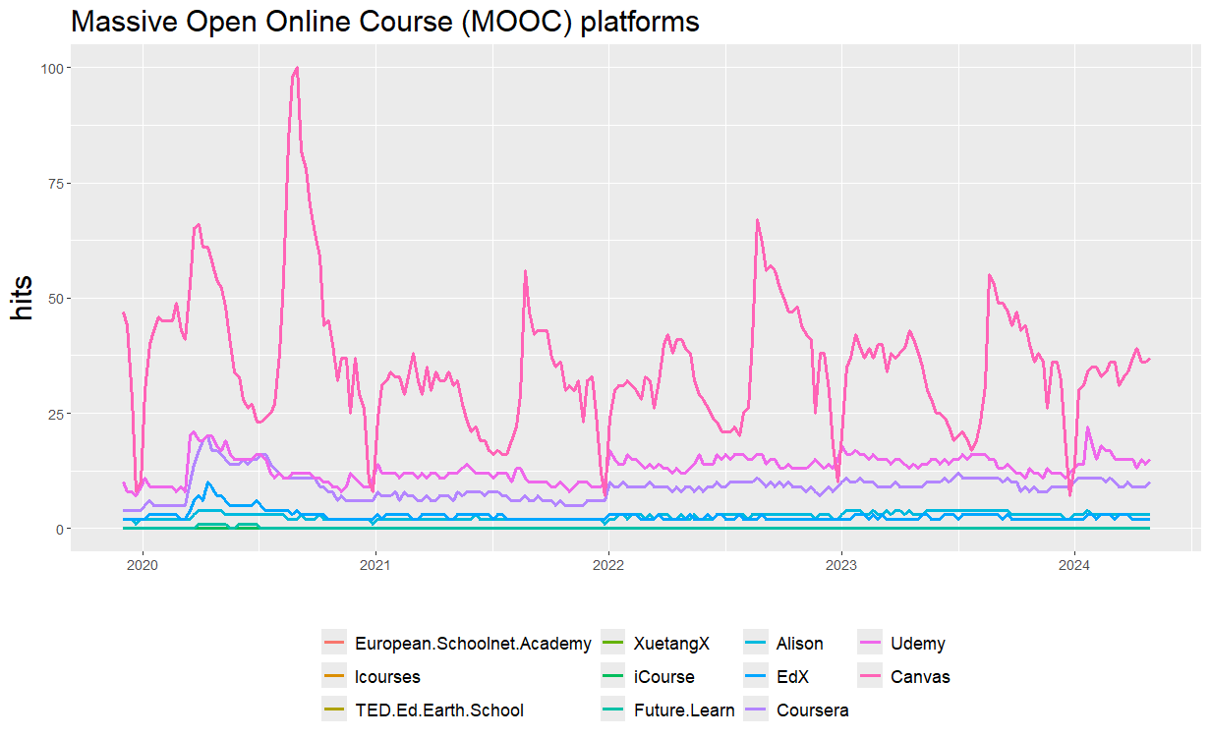
Image Source: https://www.intelligenthq.com/wp-content/uploads/2018/06/Online-course-certificates.jpg
Notes:
Web-based platforms offering Massive Open Online Courses (MOOCs) that are accessible to anyone with an internet connection.

Slide 16

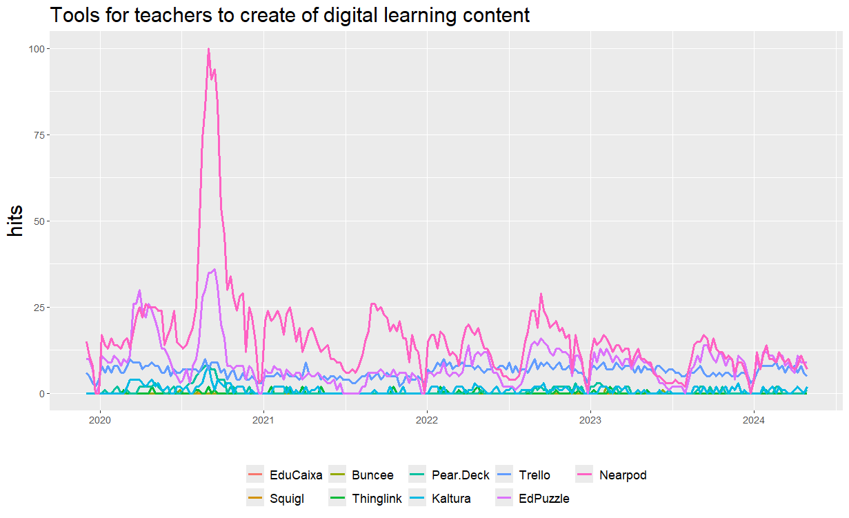
Image Source: https://www.linkedin.com/pulse/lack-training-teachers-use-new-technologies-why-our-education-/

Slide 17

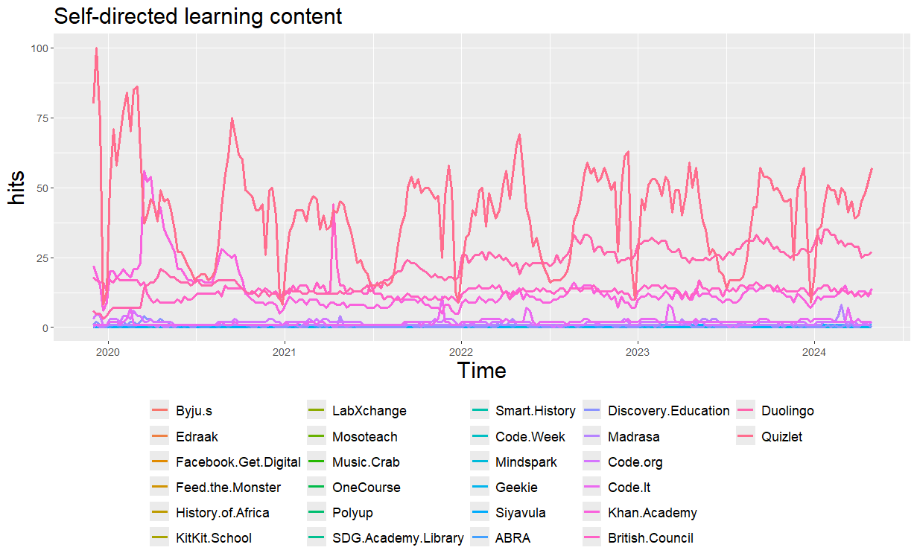
Image Source: https://easy-peasy.ai/ai-image-generator/images/self-directed-learning-unlock-educational-journey

Slide 18

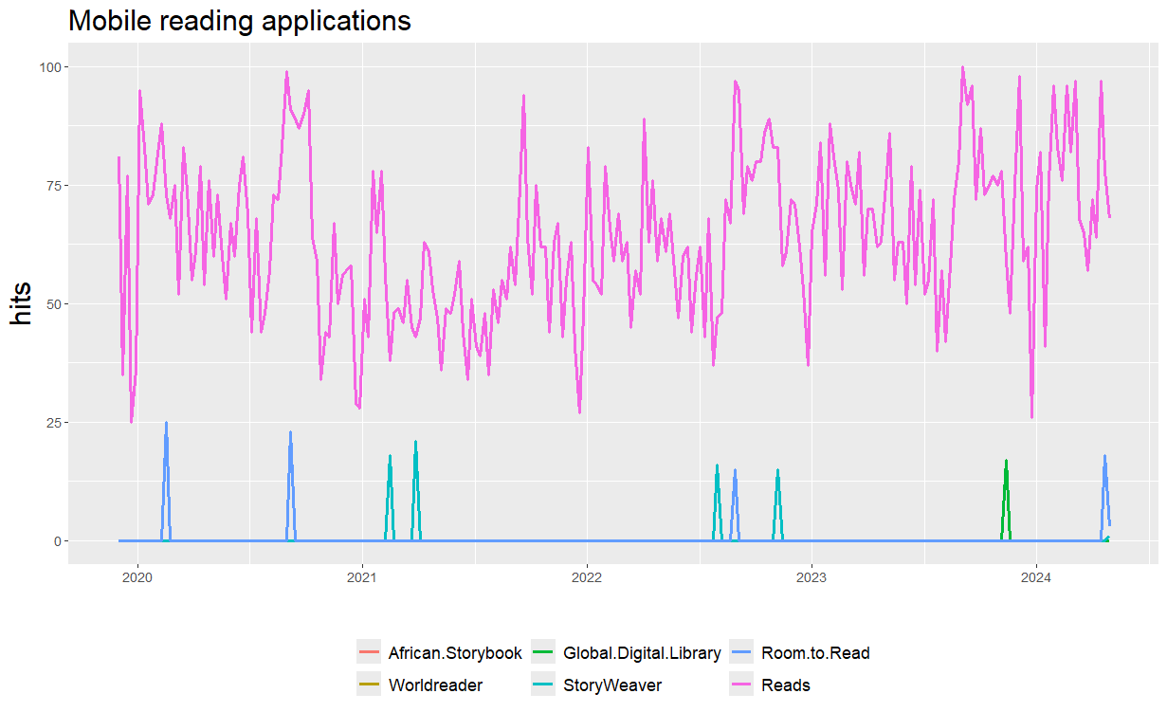
Image Source: https://beerconnoisseur.com/sites/default/files/blogs/2022/role_of_education_in_the_modern_world_of_technologies/remote-working-1024x681-1-900x599-1.jpg

Slide 19

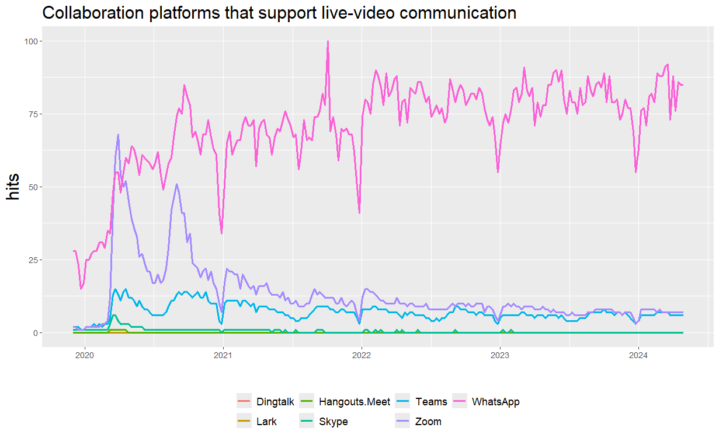
Image Source: https://s39613.pcdn.co/wp-content/uploads/2021/05/during-covid19-attractive-woman-gestures-during-virtual-meeting-with-picture-id1293927641.jpg

Slide 20

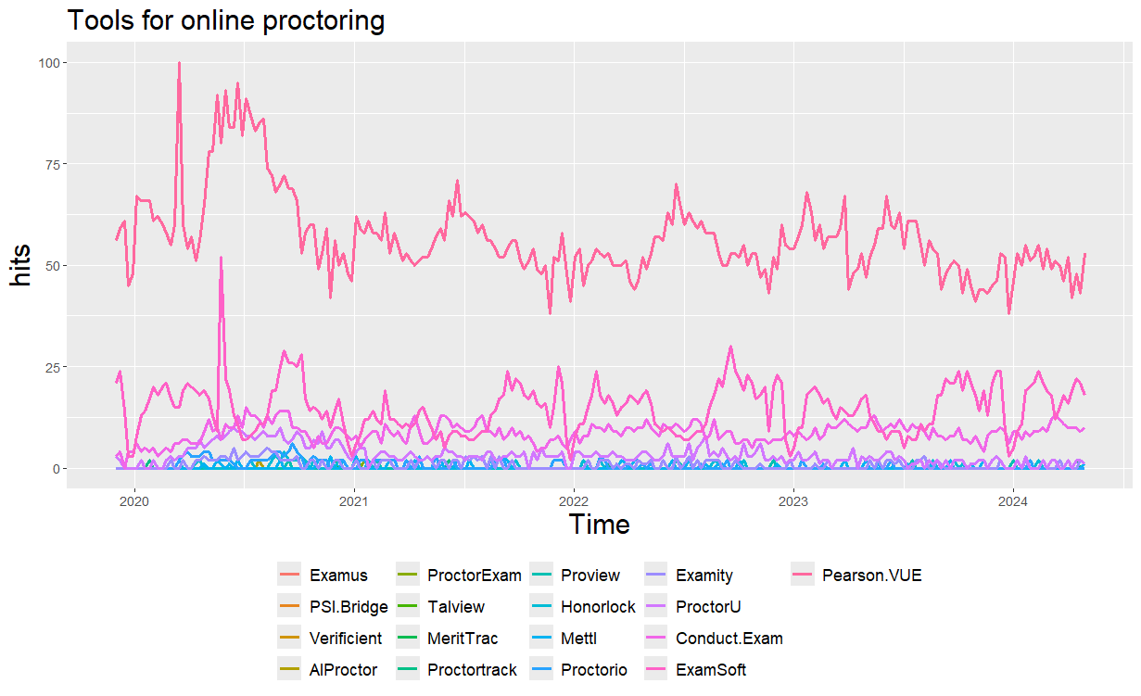
Image Source: https://cdn.elearningindustry.com/wp-content/uploads/2021/01/is-remote-proctoring-the-future-of-academia.png

Slide 21

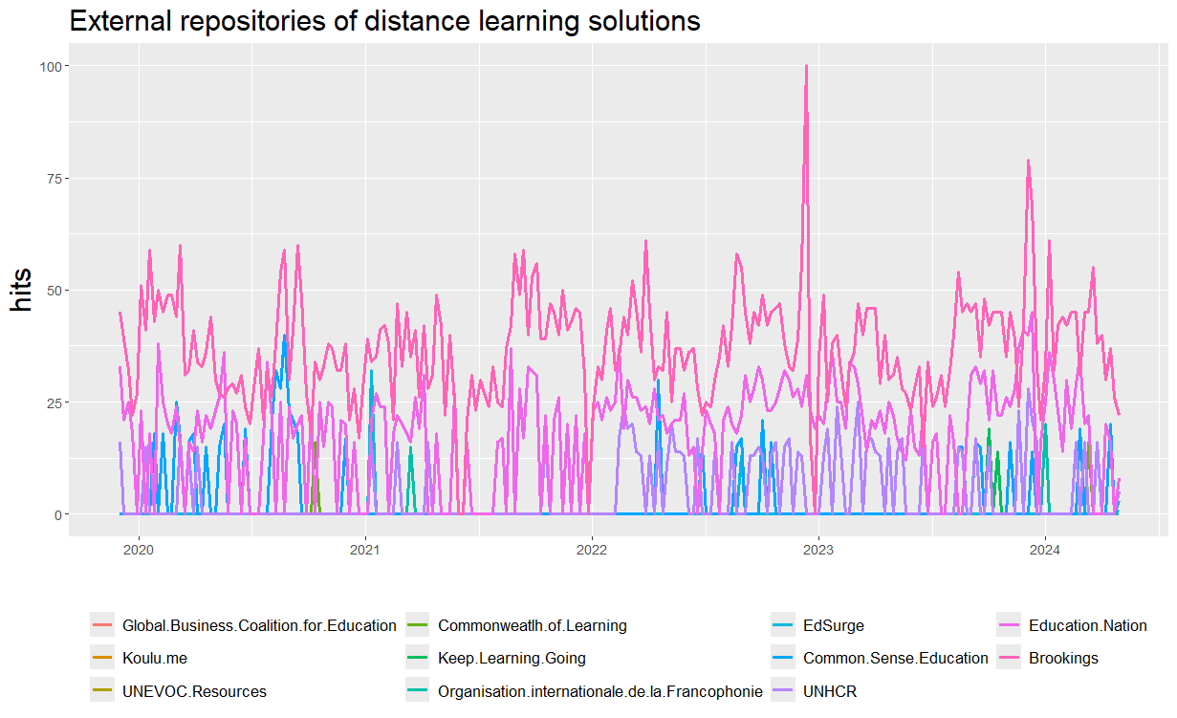
Image Source: https://www.languagemagazine.com/wp-content/uploads/2020/03/GettyImages-1174366520-300x174.jpg

Slide 22
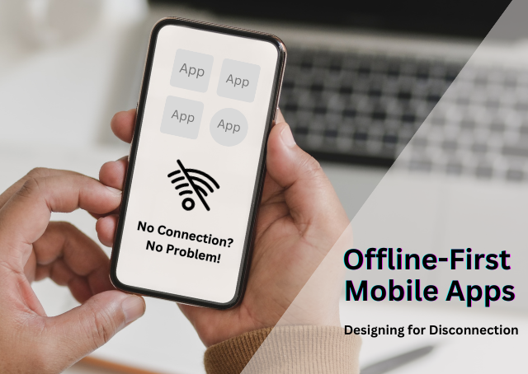
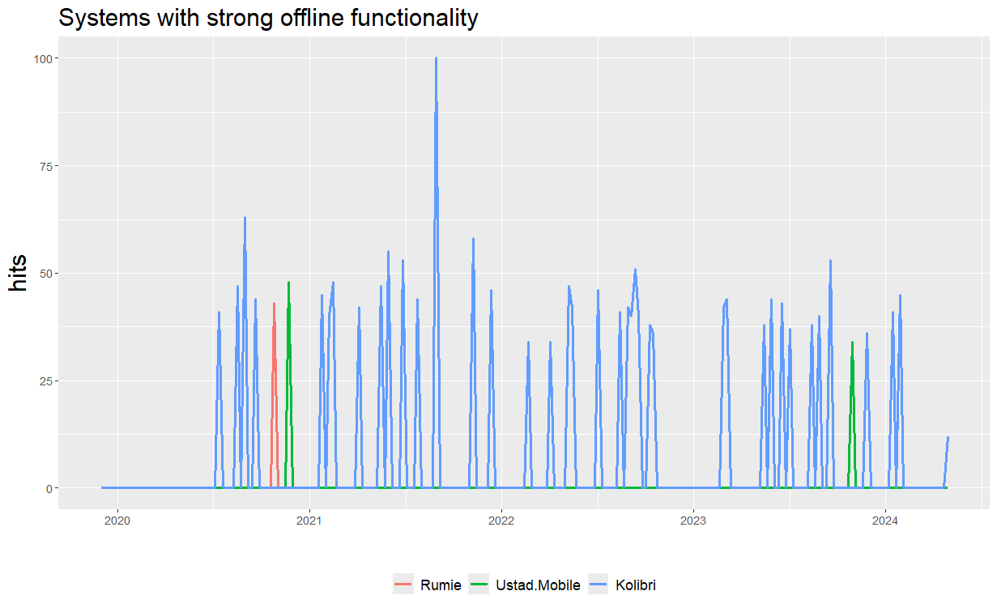
Image Source: https://medium.com/@i.vikash/designing-a-mobile-application-architecture-for-offline-use-e03e7731f4f2

Slide 23

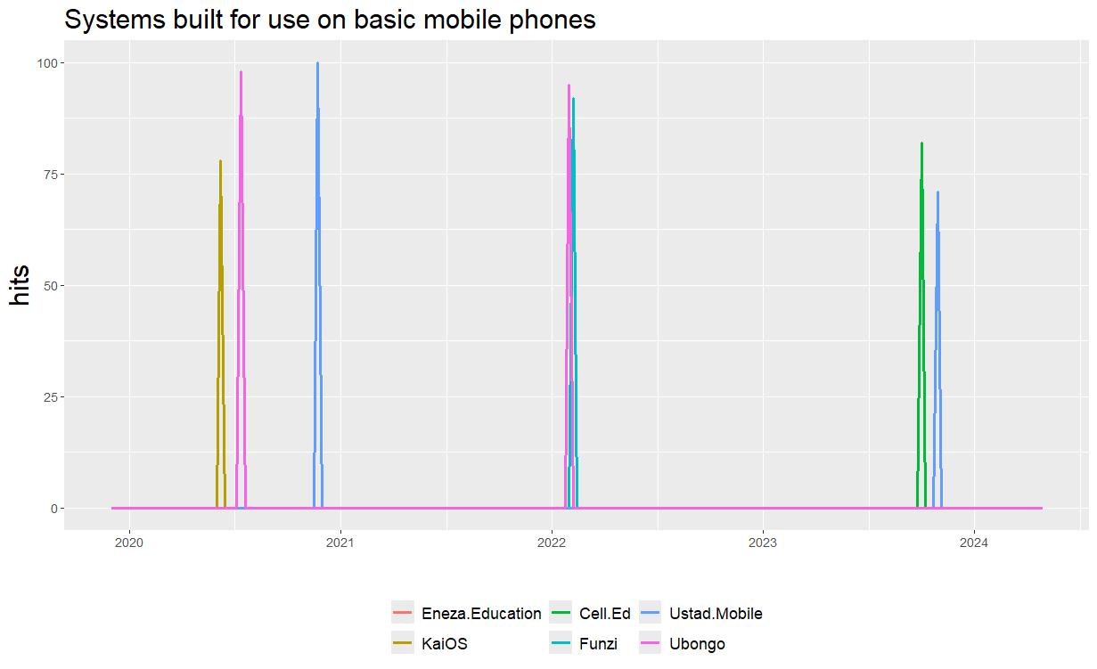
Image Source: https://elearningindustry.com/wp-content/uploads/2020/09/mobile-learning-what-is-it.jpg

Slide 24
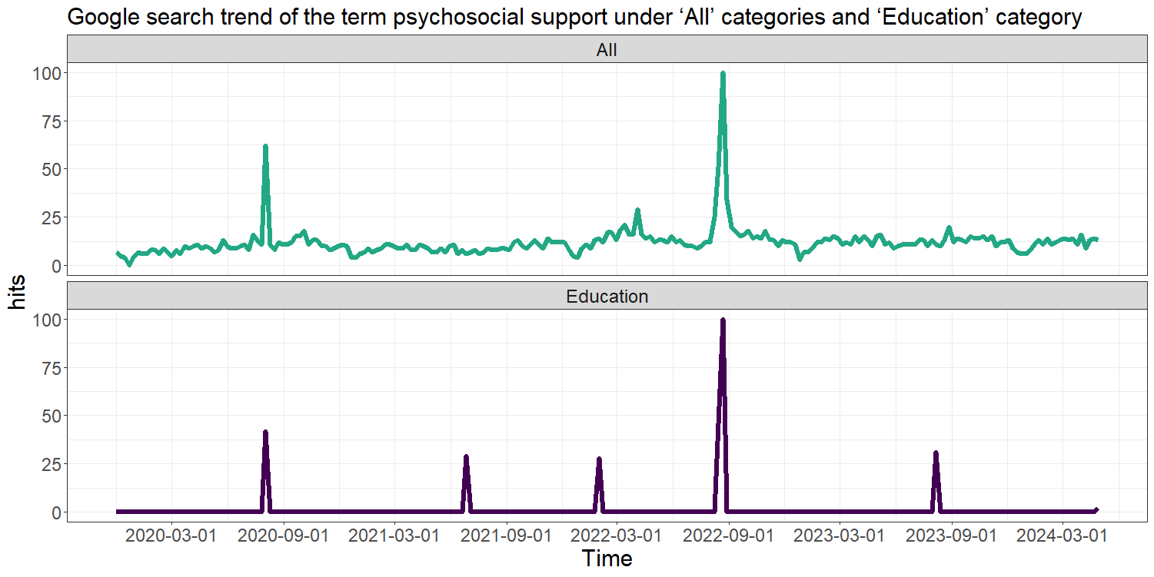
Effective psychosocial support is very important for improving the mental health and overall well-being of students and teachers during a pandemic.
Align with academic breaks in most parts of the world.

Slide 25
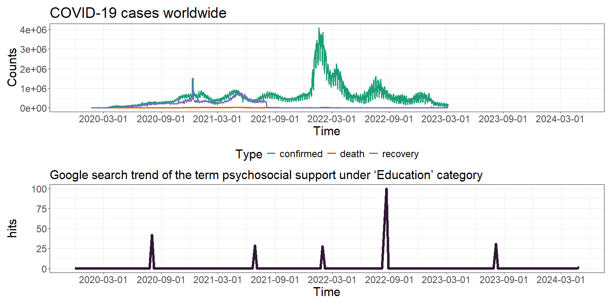
Analyzing secondary data in this manner is very important, as these characteristics may be overlooked due to lack of engagement and communications between the students and the educators during school closures.
Notes:
Analyzing secondary data in this manner is critical, as these characteristics
may be overlooked due to decreased engagement and communication between students and
educators during school closures.

Slide 26
What Next ?
Enables informed decision-making with minimal time and effort.
Popularity does not guarantee quality.
Future research should evaluate the efficiency and effectiveness of popular tools to ensure engaging online learning experiences.
Reflects search behaviour of internet users only.
Further investigation at national and regional levels to understand the specific needs and challenges in different areas
Further research should assess the accuracy, reliability, and coverage of Google Trends data to enhance its utility (Cebrián et al. ,2023)
Notes:
Quantifies popularity and public interest in distance education during the pandemic.Highlights that popularity does not guarantee quality.

Slide 27

Thank you
This work was supported in part by the RETINA research lab, funded by the OWSD, a program unit of the United Nations Educational, Scientific, and Cultural Organization (UNESCO).
Data and codes available at: https://github.com/pridiltal/CARMA2024_Analysis
Slides available at
Priyanga Dilini Talagala
PhD (Monash)
prital.netlify.app
pridiltal
Thiyanga S. Talagala
PhD (Monash)
thiyanga.netlify.app
thiyangt

Slide 29
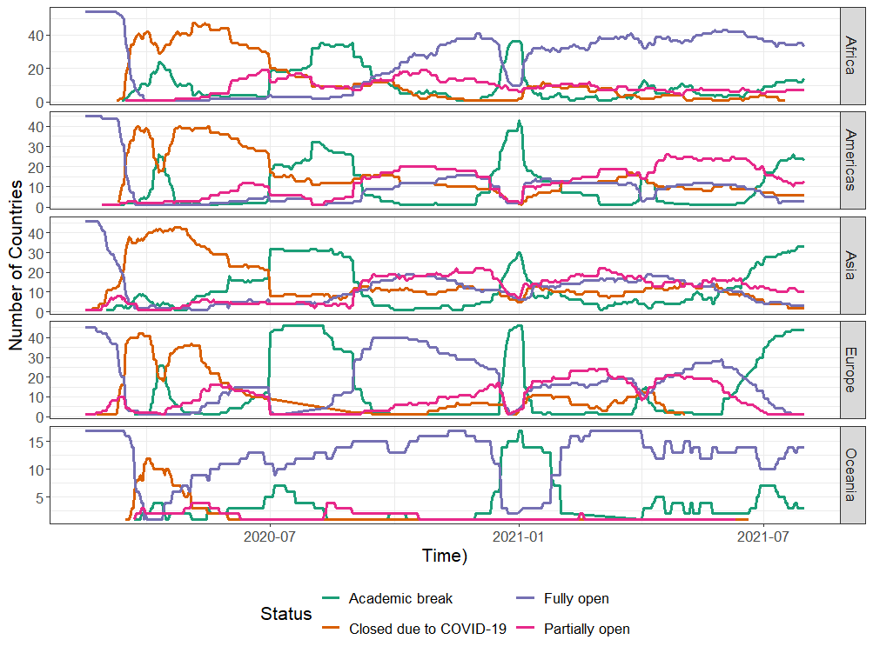
Region wise tracking of COVID-19 caused school closures and re-openings
Source: UNESCO (2020). COVID-19 educational disruption and response. [Online; accessed 13-May-2020]. https://en.unesco.org/covid19/educationresponse
Notes:
This is the region wise..
Aside form Africa and Oceania other regions have taken a long time to fully reopen their schools

Slide 30
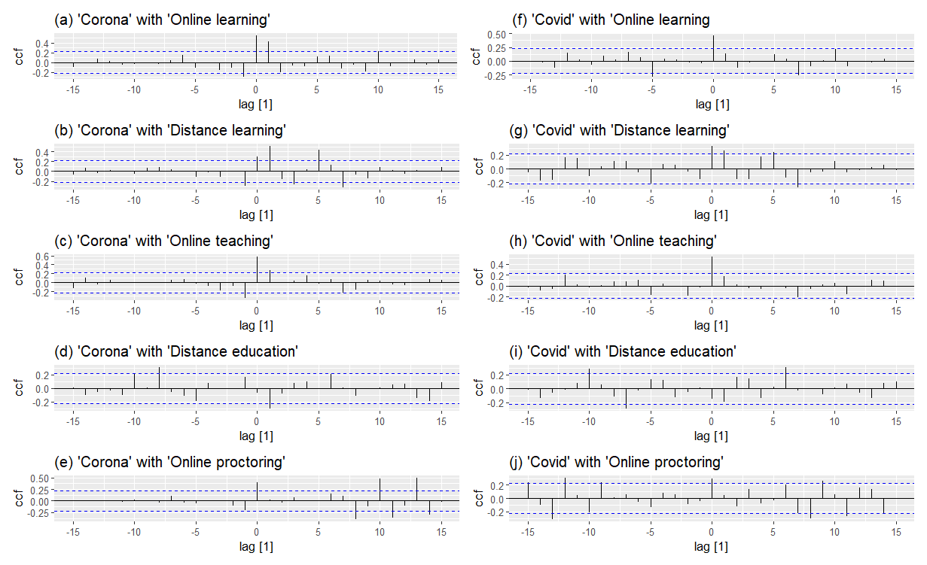

Slide 31
Main Contributions
Facilitates navigation through the multitude of market options available.
Enables informed decision-making with minimal time and effort.
Provides valuable information for identifying competitors and enhancing tool efficacy.
Guides developers and educational institutions to improve and innovate existing tools.
Highlights the critical need to address overlooked aspects of mental health support during academic breaks and school closures.

Slide 32
Segmentation of Analysis
Digital learning management systems: Platforms for organizing, delivering, and tracking educational content and activities online.
Systems designed for basic mobile phone usage: Educational tools optimized for use on simple, non-smart mobile phones.
Systems with strong offline functionalities: Learning platforms that allow access to content and activities without an internet connection.
Massive Open Online Course (MOOC) platforms: Online platforms offering free or low-cost courses to a large number of participants.
Self-directed learning resources: Materials and tools that enable learners to study independently at their own pace.

Slide 33
Segmentation of Analysis
Mobile reading apps: Applications designed for reading e-books and other digital texts on mobile devices.
Collaboration platforms facilitating live-video communication: Tools that support real-time video interactions for group learning and meetings.
Tools for educators to create digital learning content: Software that helps teachers design and produce online educational materials.
External repositories of distance learning solutions: Online databases that provide access to a variety of remote learning resources and tools.
Tools for Online proctoring: Software that monitors and ensures the integrity of online exams.
Psychosocial support: Services and resources providing emotional and psychological assistance to learners

